Slide 1
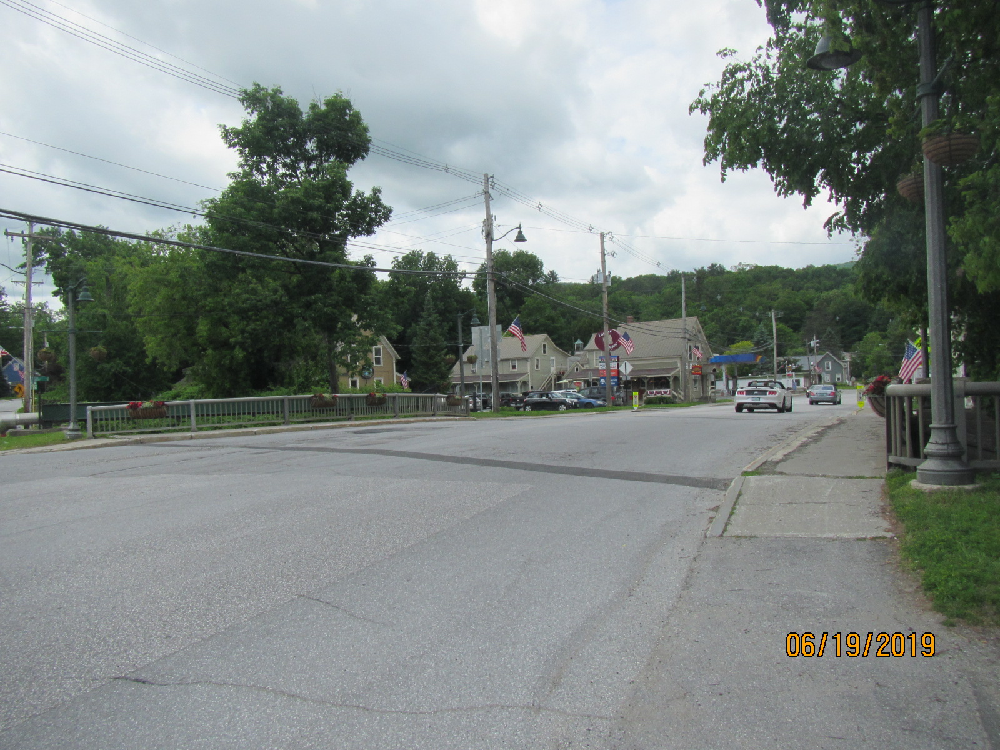
Ludlow Village: NH Deck(49)
Bridge Rehabilitation
Town Highway 1 (Main St.) – Bridge #26 over Jewell Brook
December 2, 2019

Slide 2
Introductions
JB McCarthy, P.E.
VTrans Design Project Manager
Gary Sweeny, P.E.
VTrans Design Engineer

Slide 3
Purpose of Meeting
Provide an understanding of our approach to the project
Provide an overview of existing conditions
Discuss the proposed project and traffic control
Provide an opportunity to offer input on the project.
Provide an opportunity to ask questions and voice concerns

Slide 4
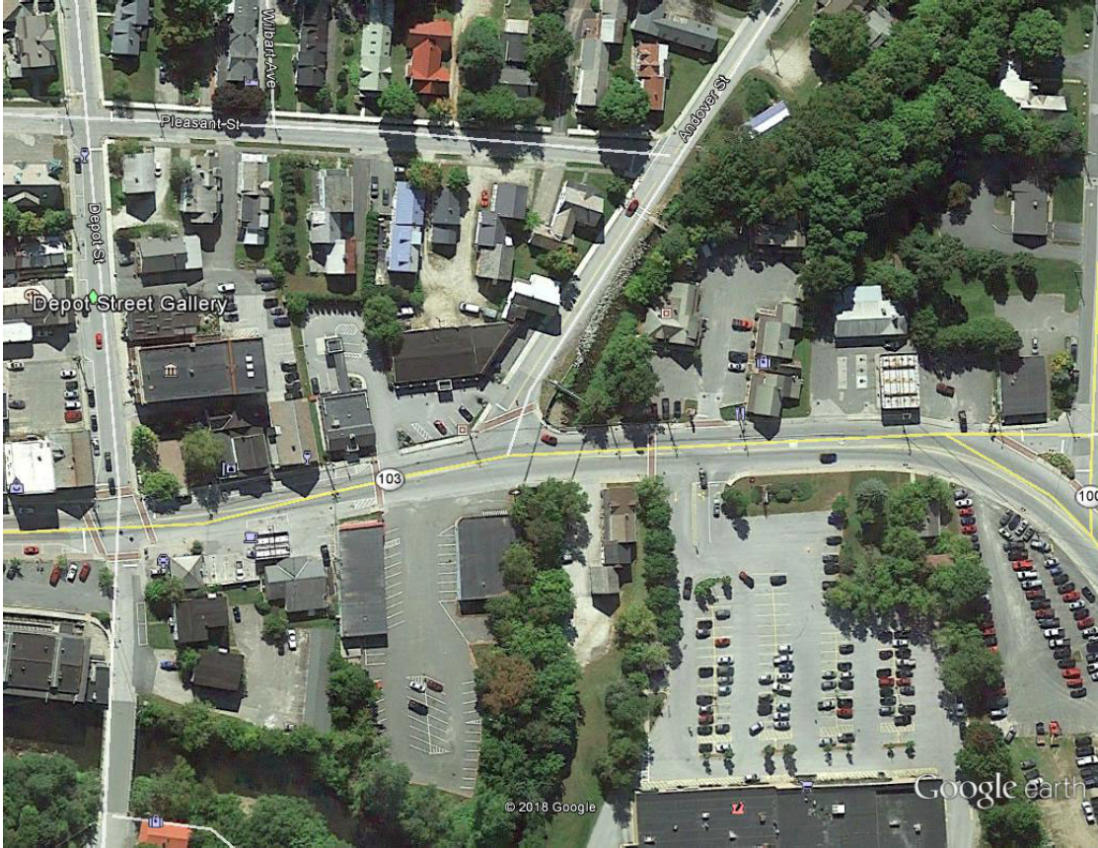
Project Location
Bridge 26
Project Location

Slide 5
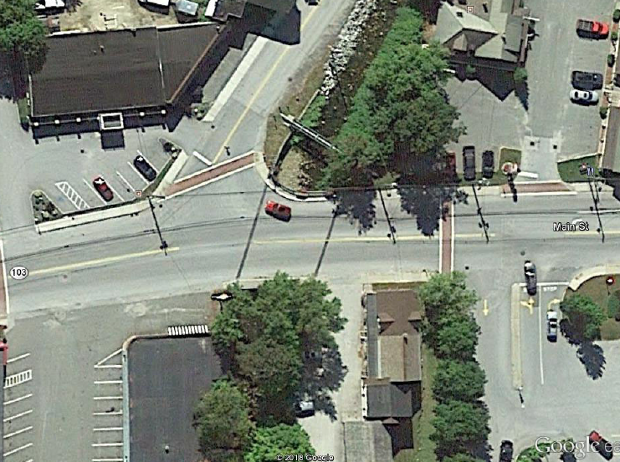
Project Location

Slide 6
Description of Terms Used

Slide 7
Looking West on Main St. over Bridge
Existing Conditions – Bridge #26
Roadway Classification – Principal Arterial, National Highway System
Bridge Type – 47’ Single Span, Rolled Beam, with Concrete Deck
Ownership – Township of Ludlow
Constructed in 1931, Rebuilt in 1965

Slide 8
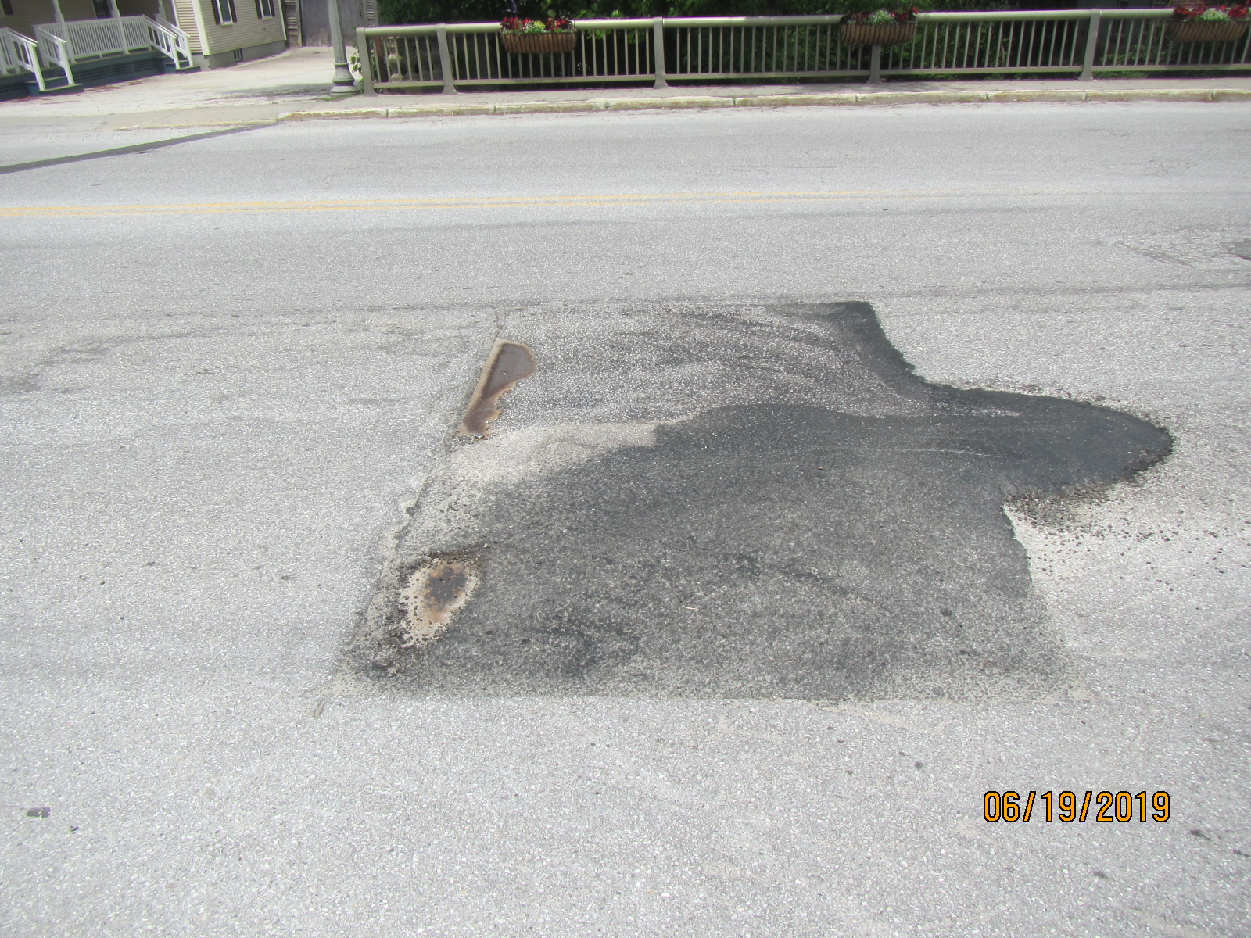
Bridge #26 - 2019 Rating:
Deck Rating: 5 (Fair)
Superstructure Rating: 7 (Good)
Substructure Rating: 6 (Satisfactory)
Channel Rating: 8 (Very Good)

Slide 9
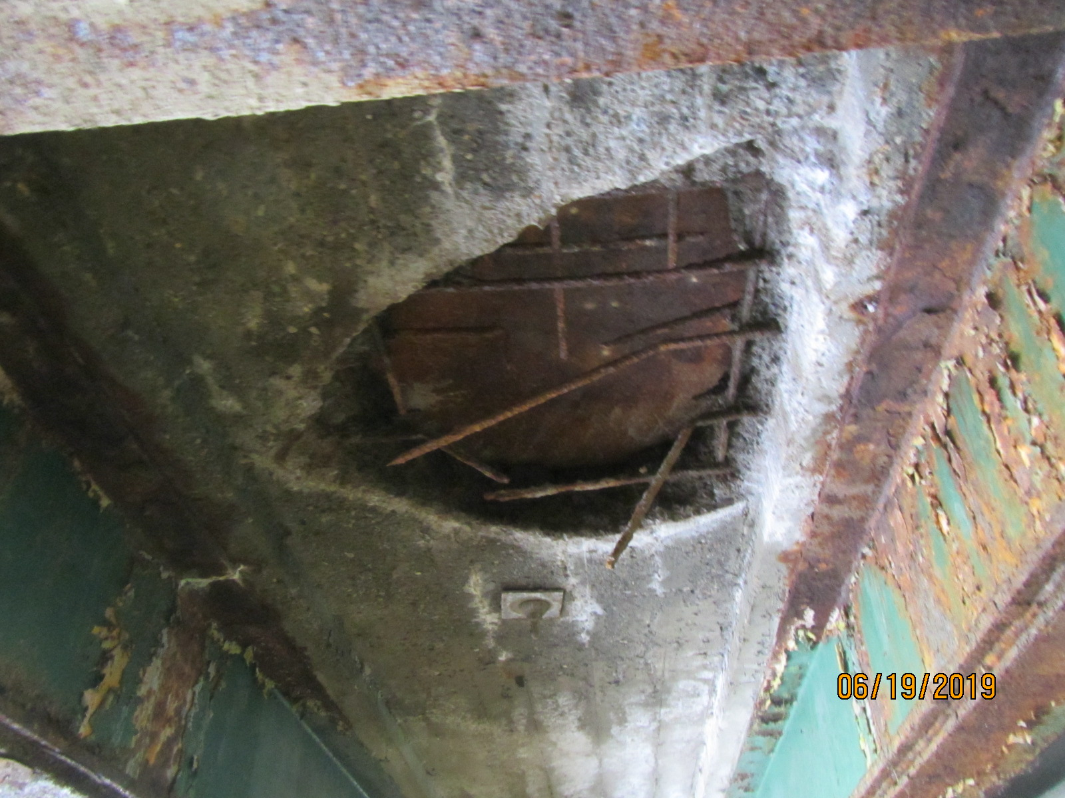
Existing Conditions – Bridge #26
The bridge is in fair condition:
  Random spots of advanced deck deterioration
  The deck in beam bay 4 has the potential for a hole
Damaged and substandard aluminum pedestrian rail should be upgraded

Slide 10
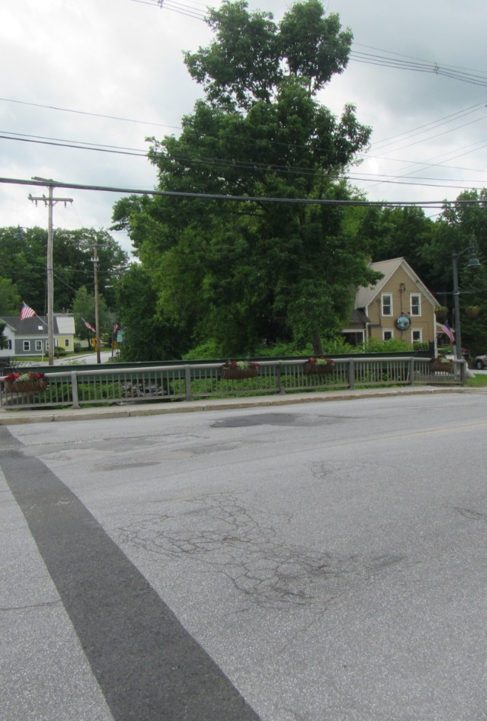
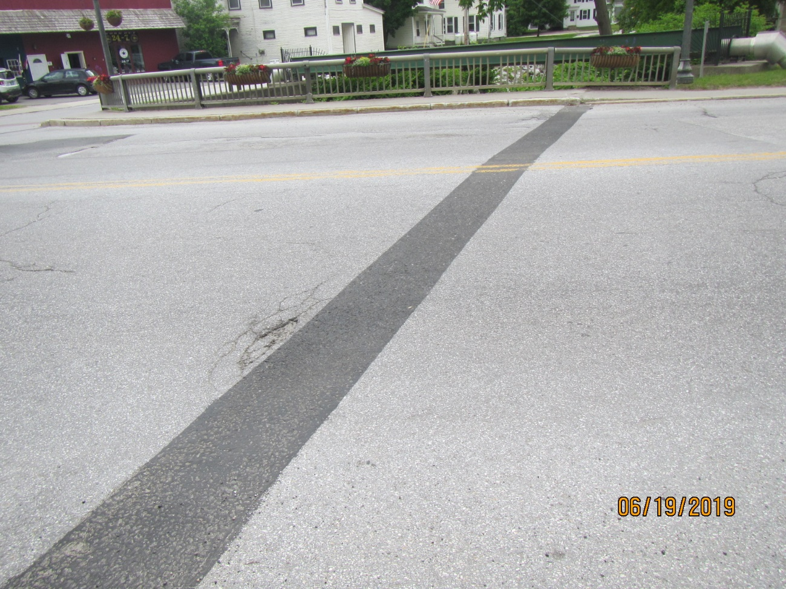
Approaches
Existing Conditions - Bridge #26

Slide 11
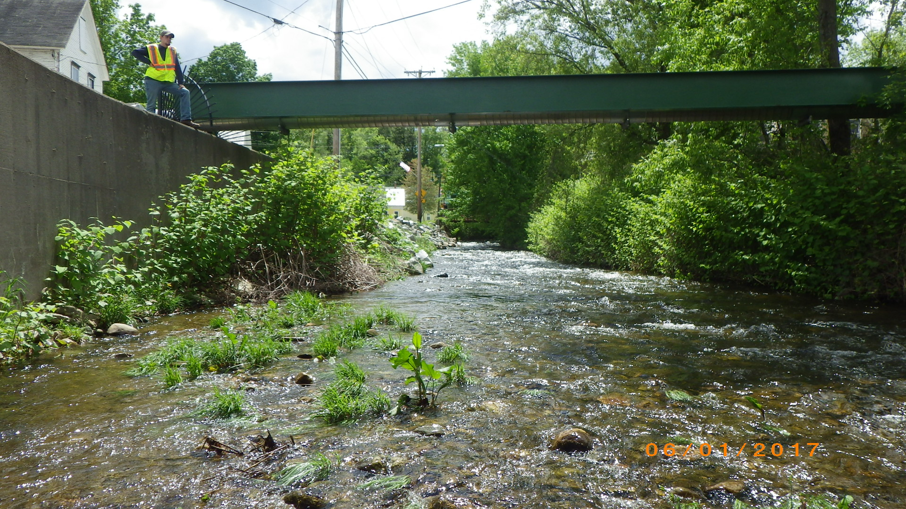
Existing Conditions
Jewell Brook Looking Upstream

Slide 12
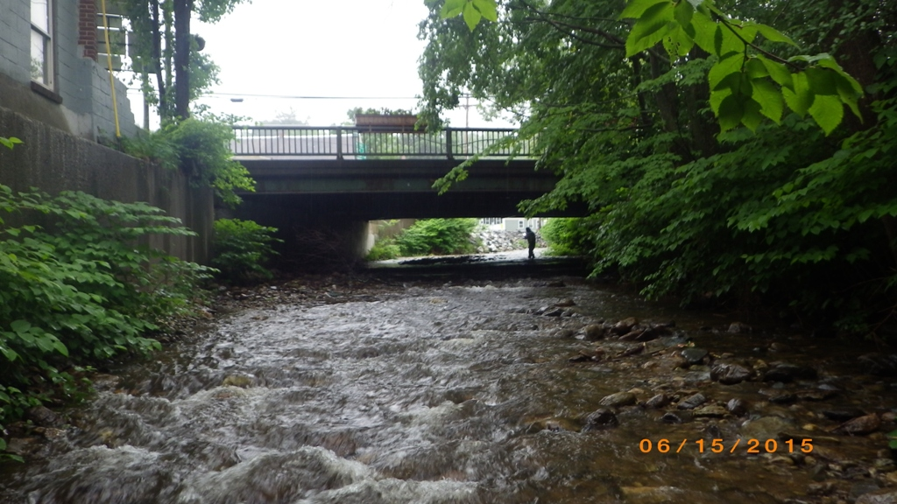
Existing Conditions - Bridge #26

Slide 13
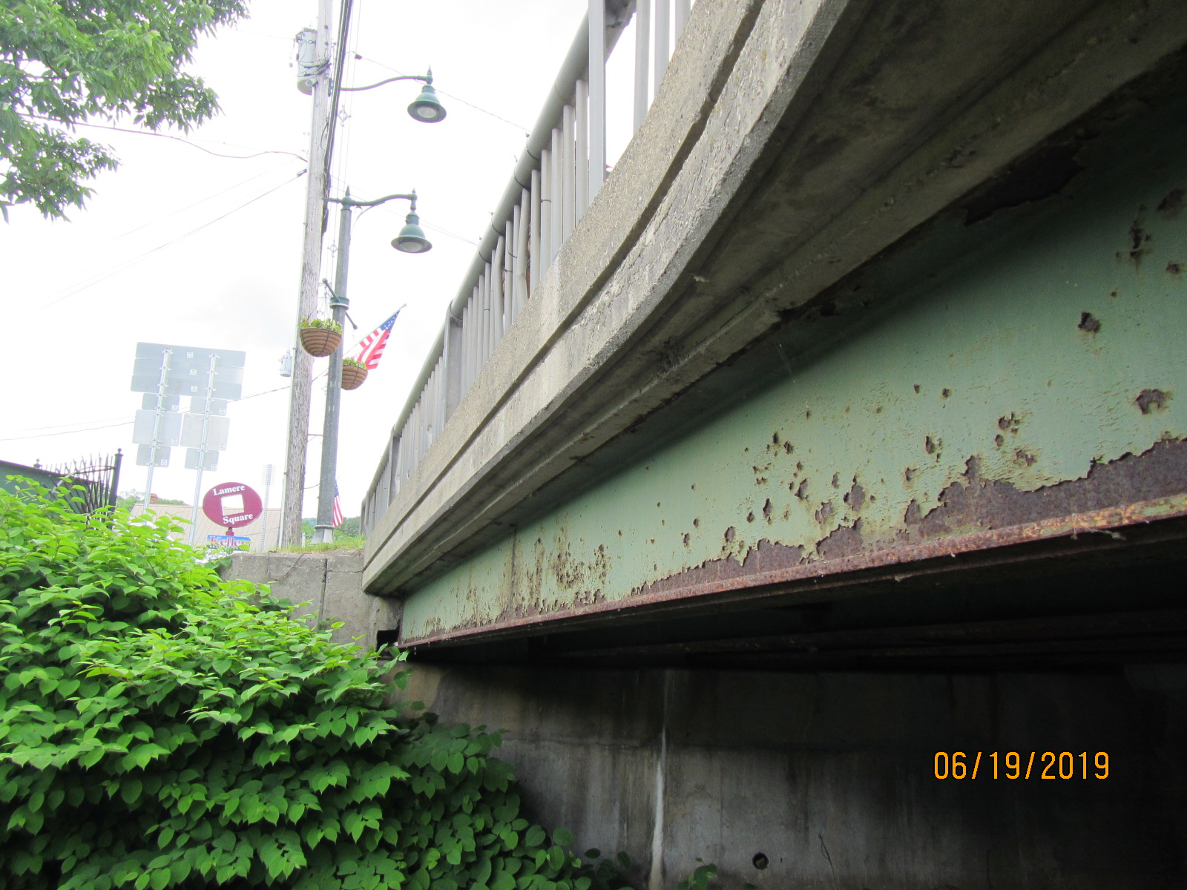
Existing Conditions - Bridge #26

Slide 14
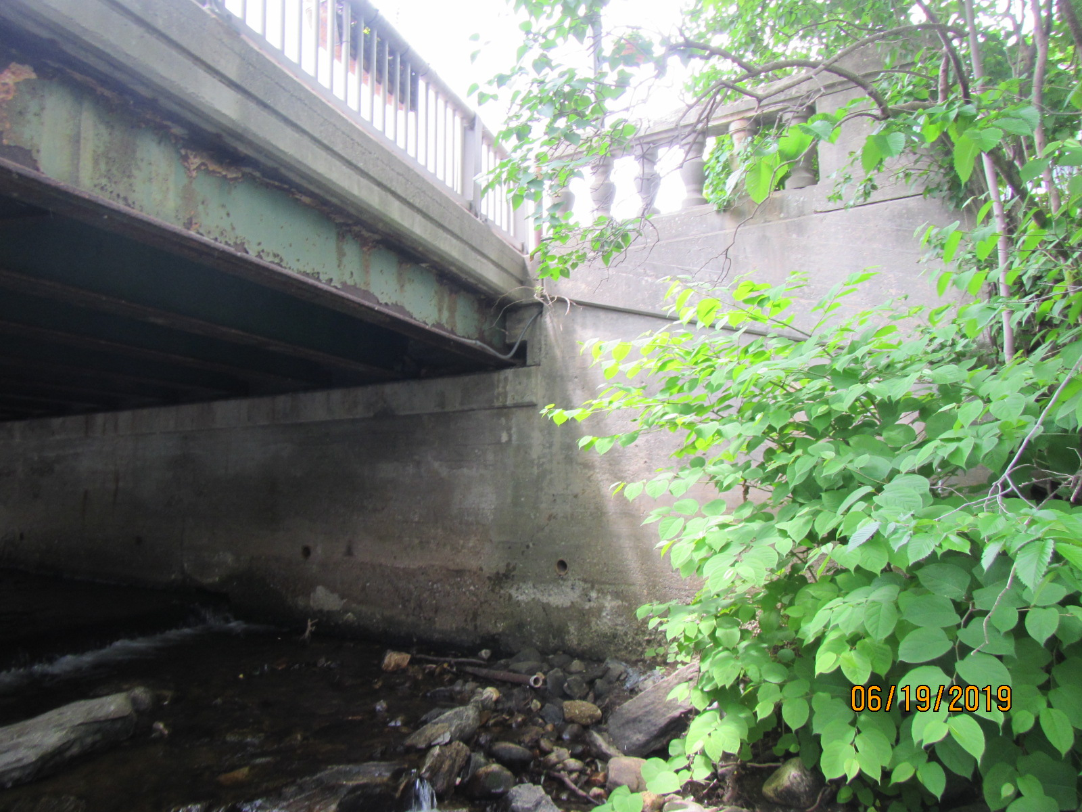
Existing Conditions - Bridge #26

Slide 15
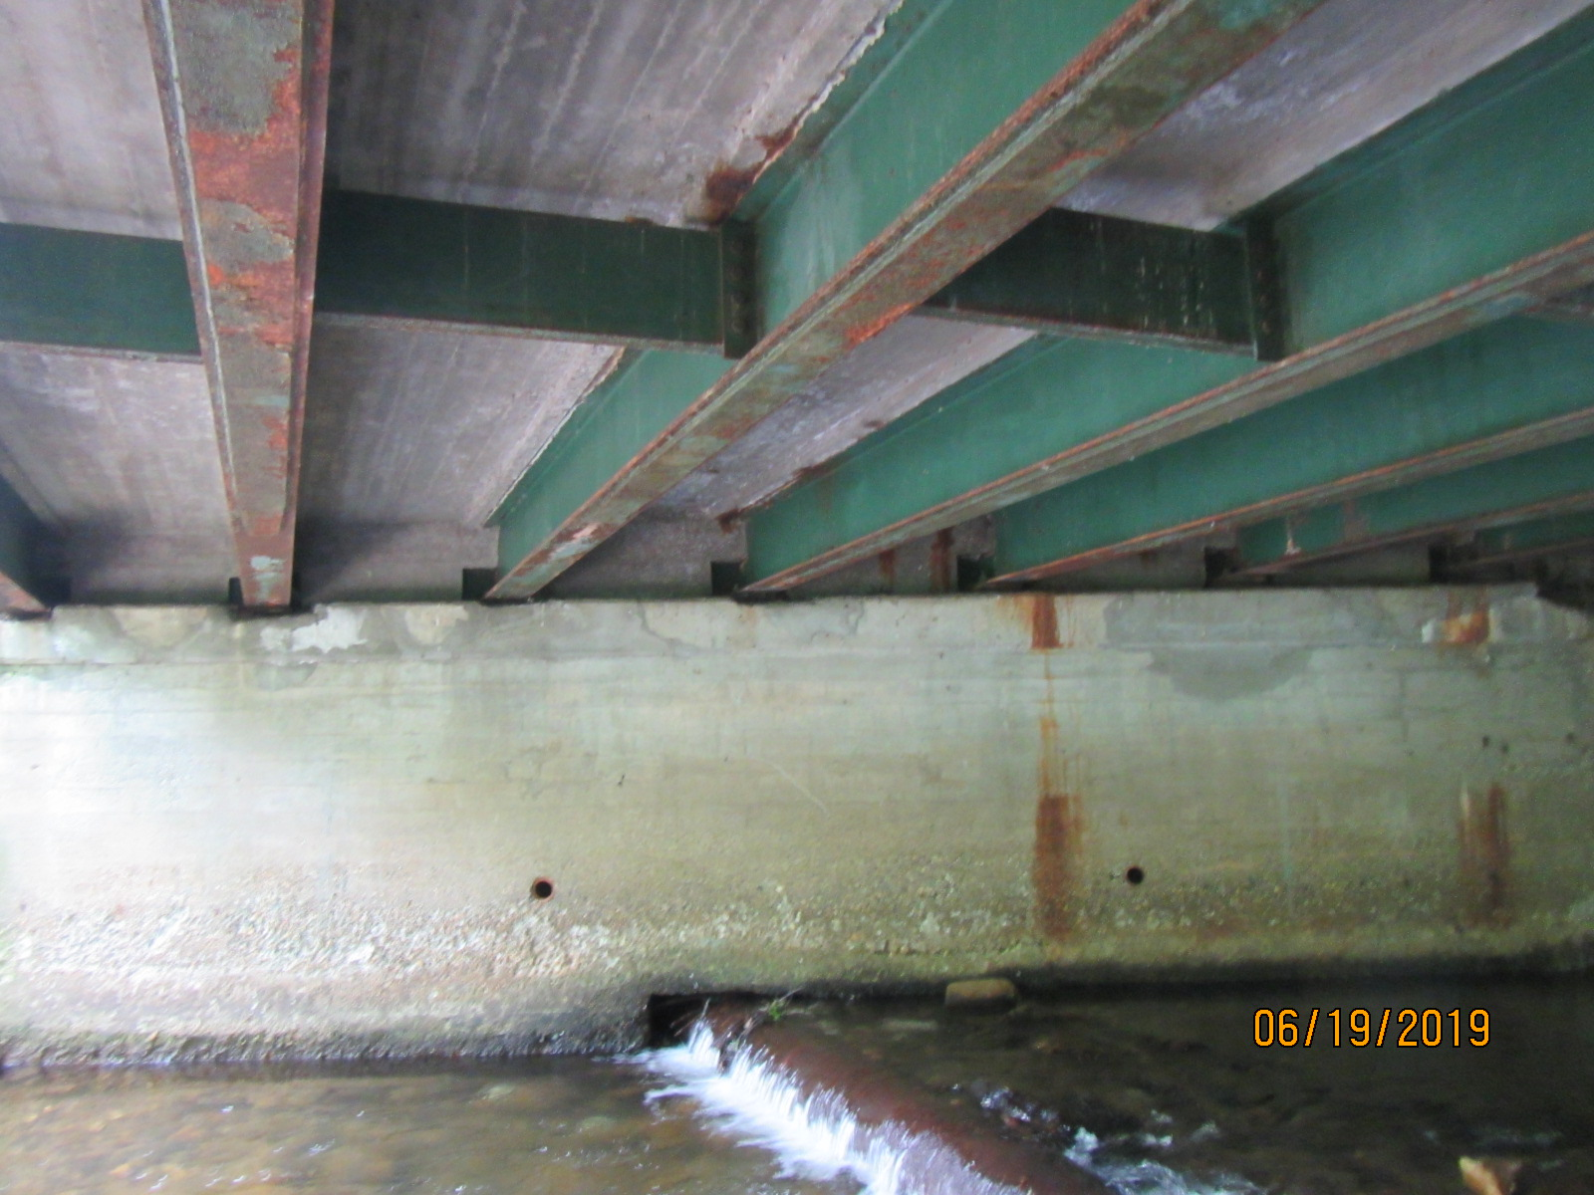
Existing Conditions - Bridge #26

Slide 16
Proposed Project - Bridge #26
Bridge Deck and Superstructure Replacement with Traffic Maintained on one lane in each direction
TH-1 (Main St.) Bridge Typical Section
  12’ Travel Lanes/10’ Shoulders/5’-0” Sidewalk/Combination Concrete/Steel Tubing Guardrails

Slide 17
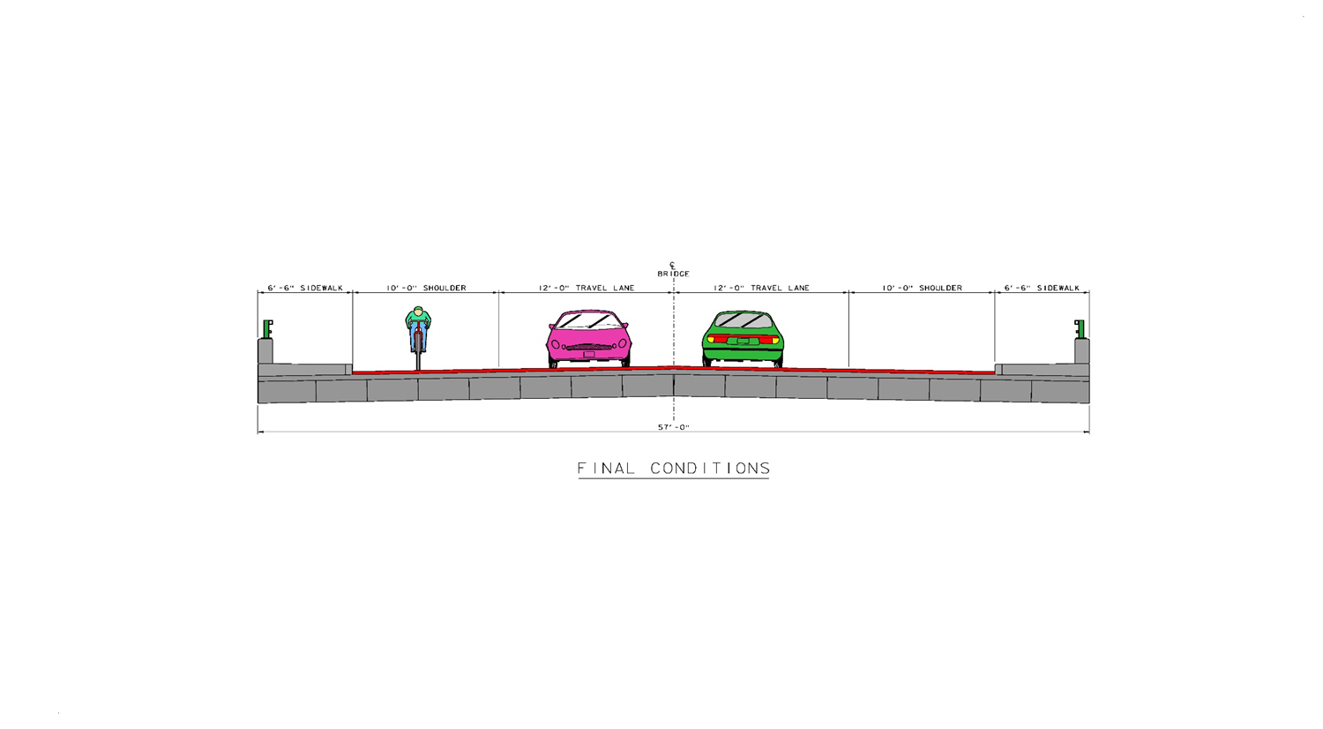
TH-1 (Main St.) Proposed Typical Section
6’6” 10’ 12’ 12’ 10’ 6’6”

Slide 18
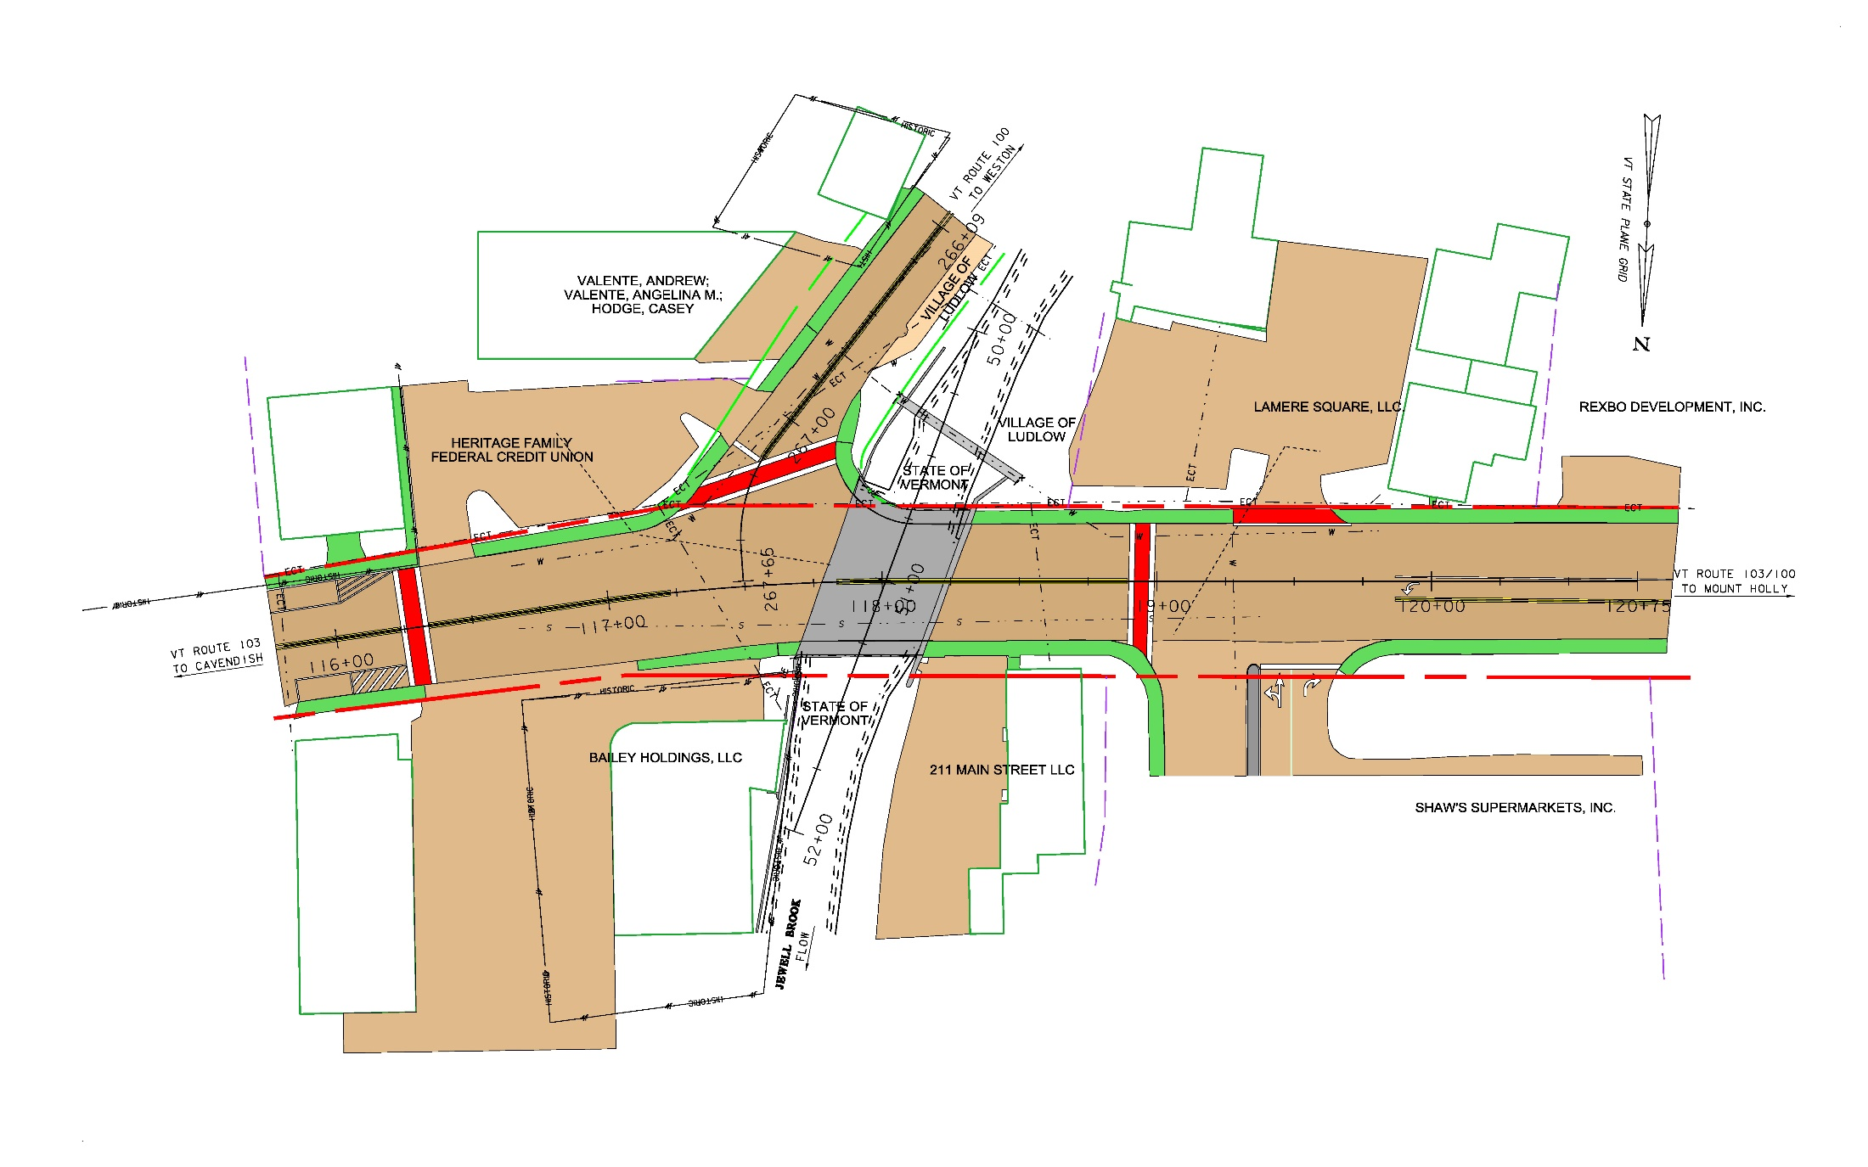

Existing Layout

Slide 19
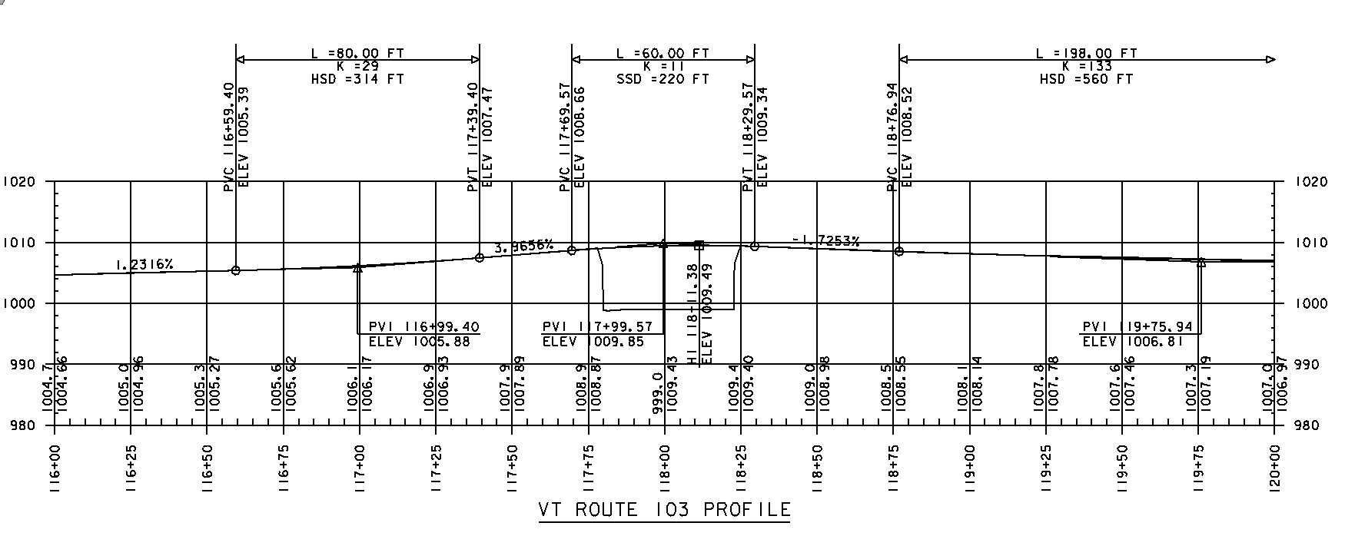
Proposed Roadway Profile

Slide 20
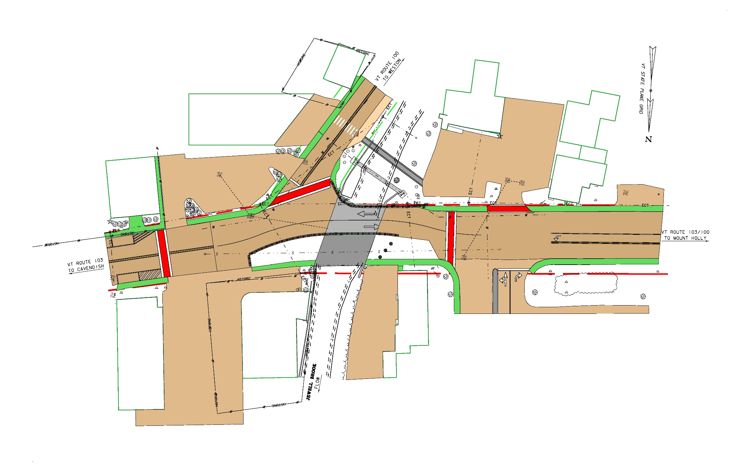
Construction Phase 1

Slide 21
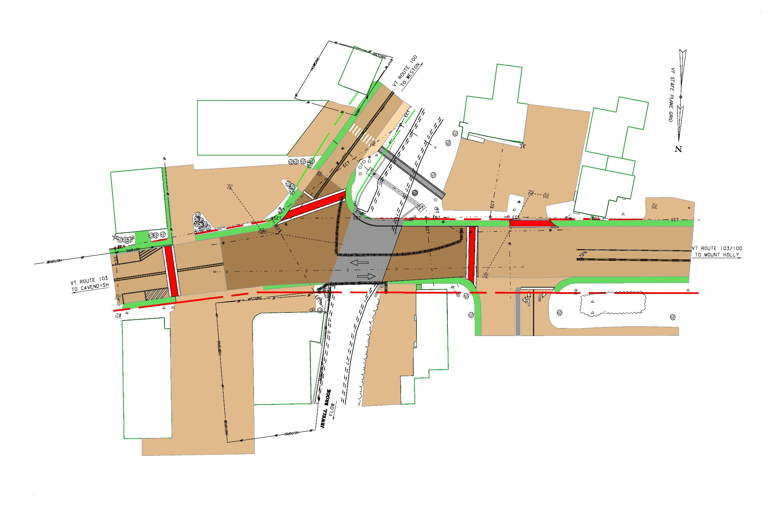
Construction Phase 2

Slide 22
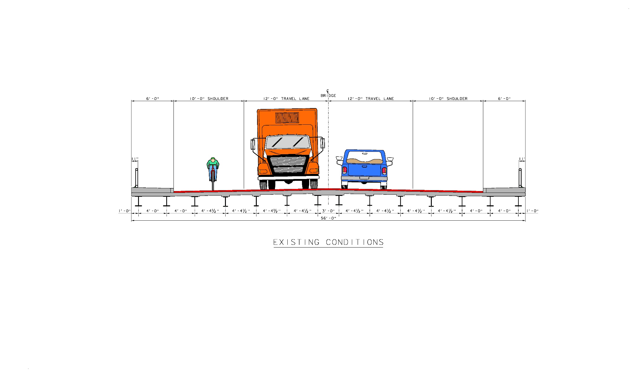
Proposed Maintenance of Traffic
Phased Construction
Existing Conditions

Slide 23
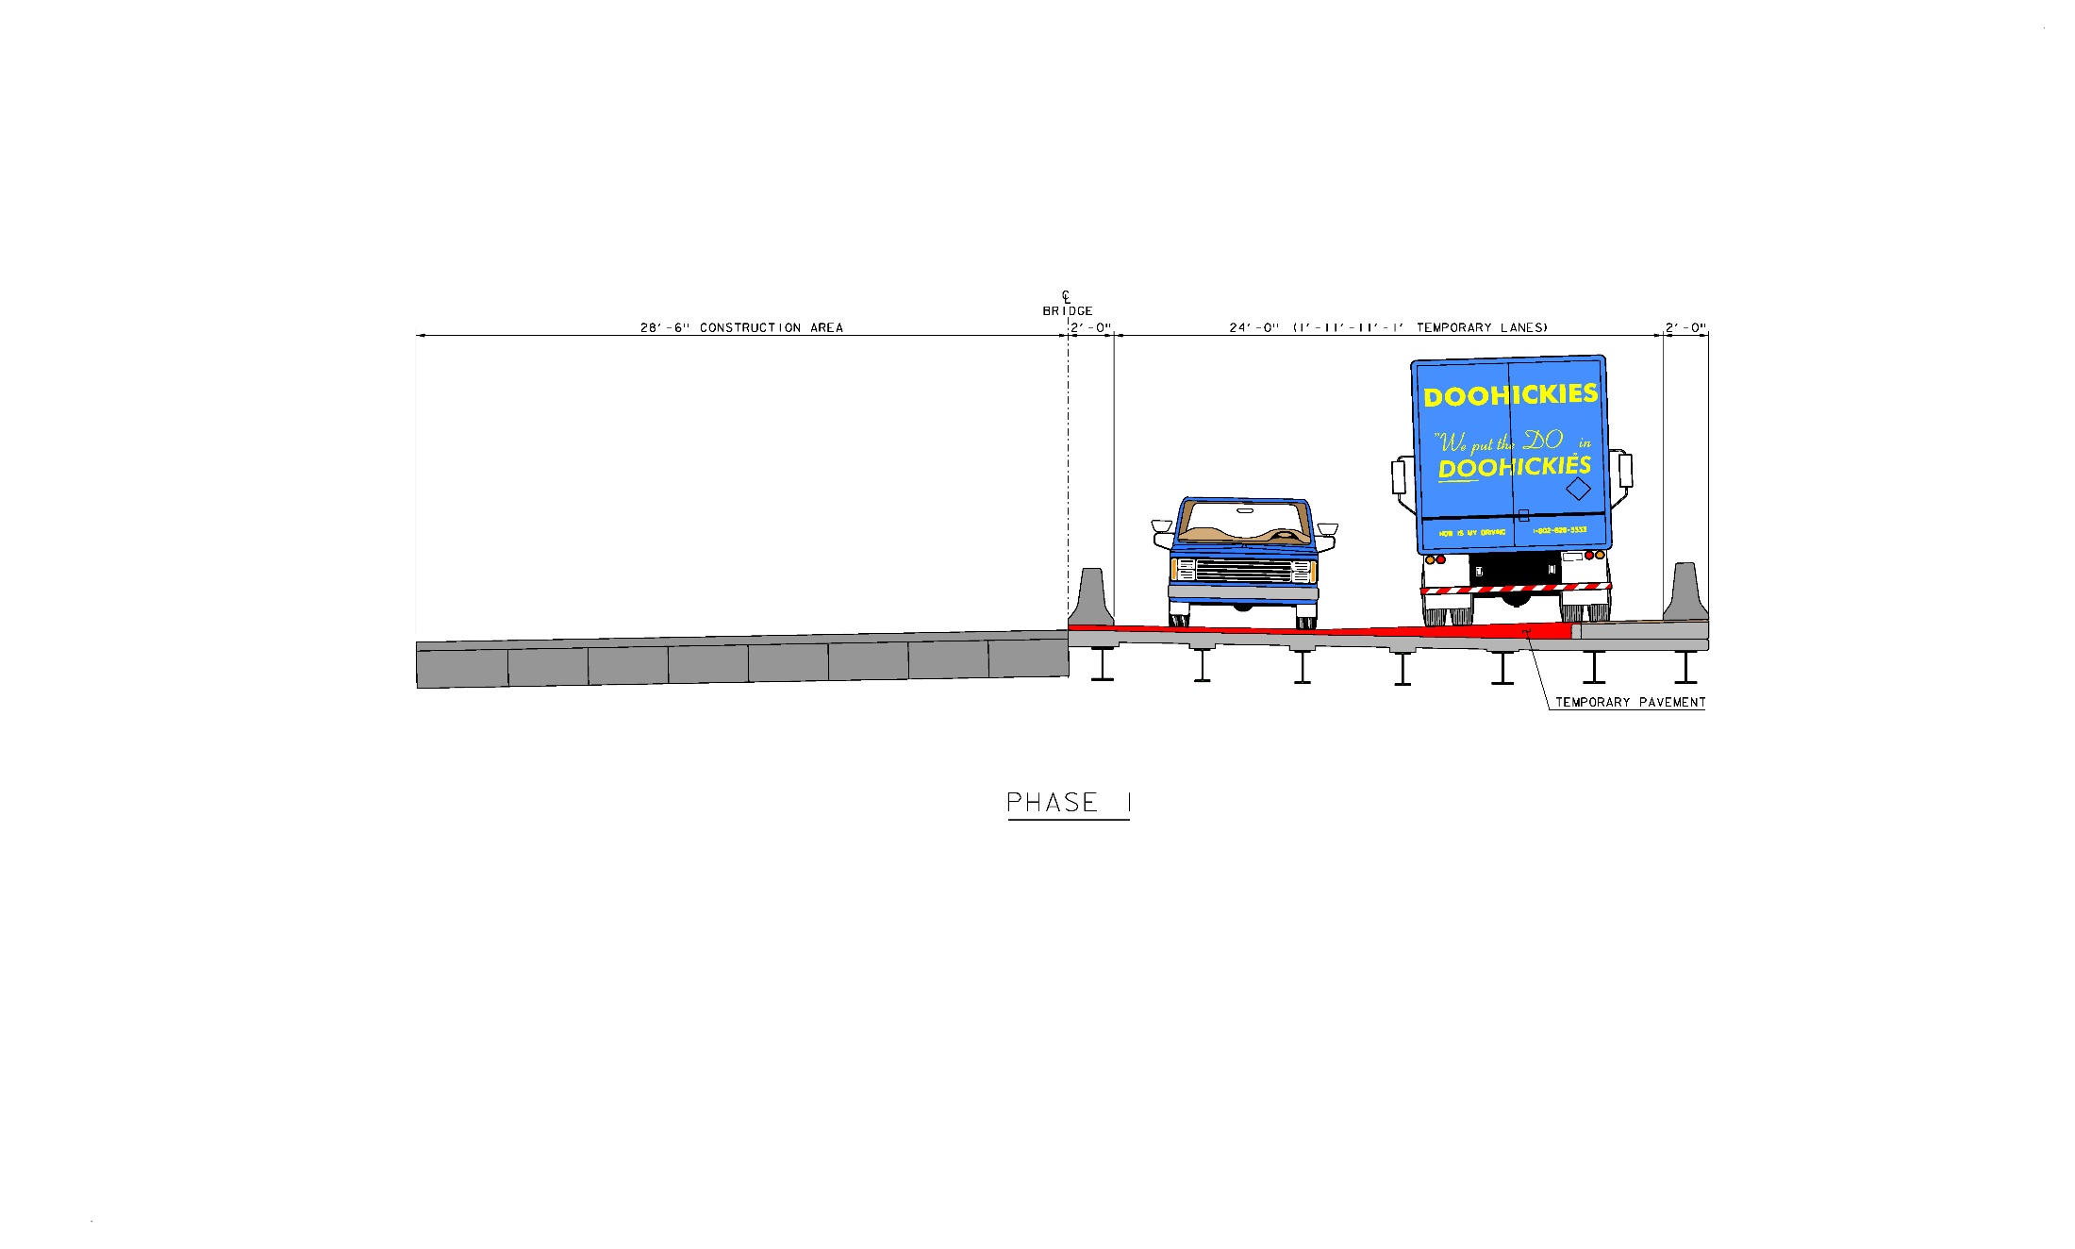
Proposed Maintenance of Traffic
Phased Construction
Phase 1

Slide 24
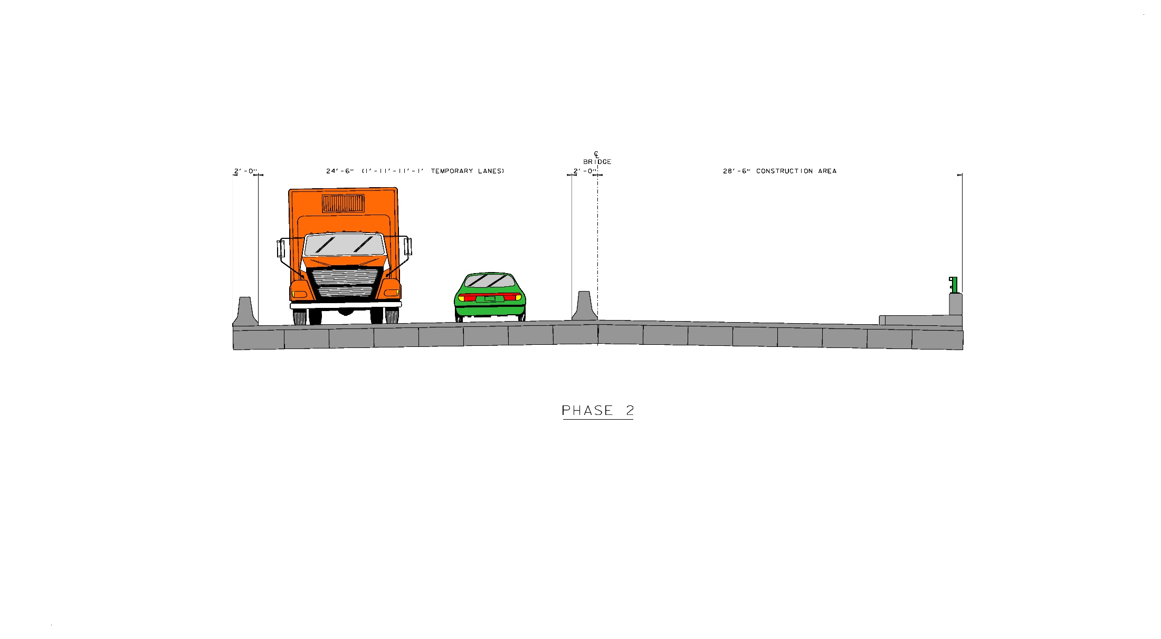
Proposed Maintenance of Traffic
Phased Construction
Phase 2

Slide 25

Proposed Maintenance of Traffic
Phased Construction
6’6” 10’ 12’ 12’ 10’ 6’6”
Final Condition

Slide 26
Project Summary
Bridge Deck and Superstructure Replacement
Traffic Maintained on one lane in each direction.
Town share to be 5%
TH-1 (Main St.)
  12’ Travel Lanes/10’ Shoulders/5’-6” Sidewalk/Concrete Barrier with Steel Tubing Guardrail

Slide 27
Preliminary Project Schedule
Target Construction Schedule (2022):
  May 1 Work Begins
  June 1 Temporary Traffic Pattern in place Phase 1
  August 1 Phase 1 Complete
  August 1 Temporary Traffic Pattern in place Phase 2
  October 1 Normal Traffic Pattern Resumes
  November 1 Project Complete

Slide 28
Preliminary Project Budget
Conceptual Level Budget Estimate
  Construction Cost: $1,615,000
  (including Contingencies and
  Construction Engineering)
  Preliminary Engineering Costs: $210,000
  Right of Way: $25,000
  Conceptual Project Cost Estimate: $1,850,000
  Town Share 5% - Approximately $92,500

Slide 29
Town Considerations
Confirm Scope of Project
Replacement deck and superstructures one half at a time while maintaining two lanes of traffic.

Slide 30
Town Considerations
How will truck traffic on VT 100 be handled? How is it handled now?

Slide 31
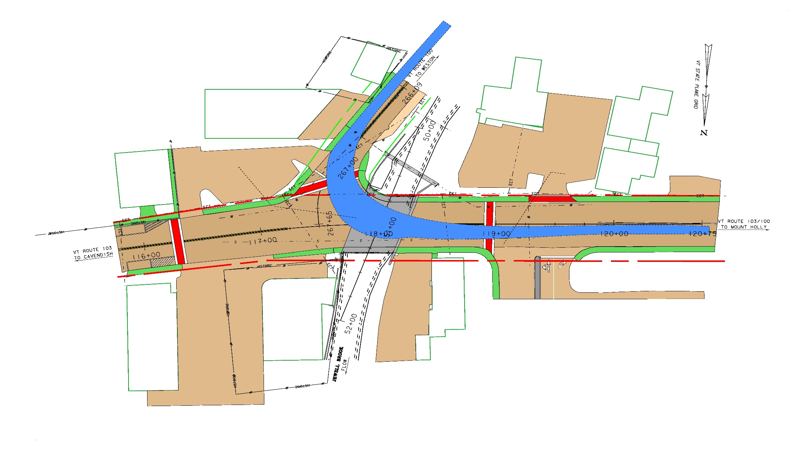
Truck Movements – Northbound

Slide 32
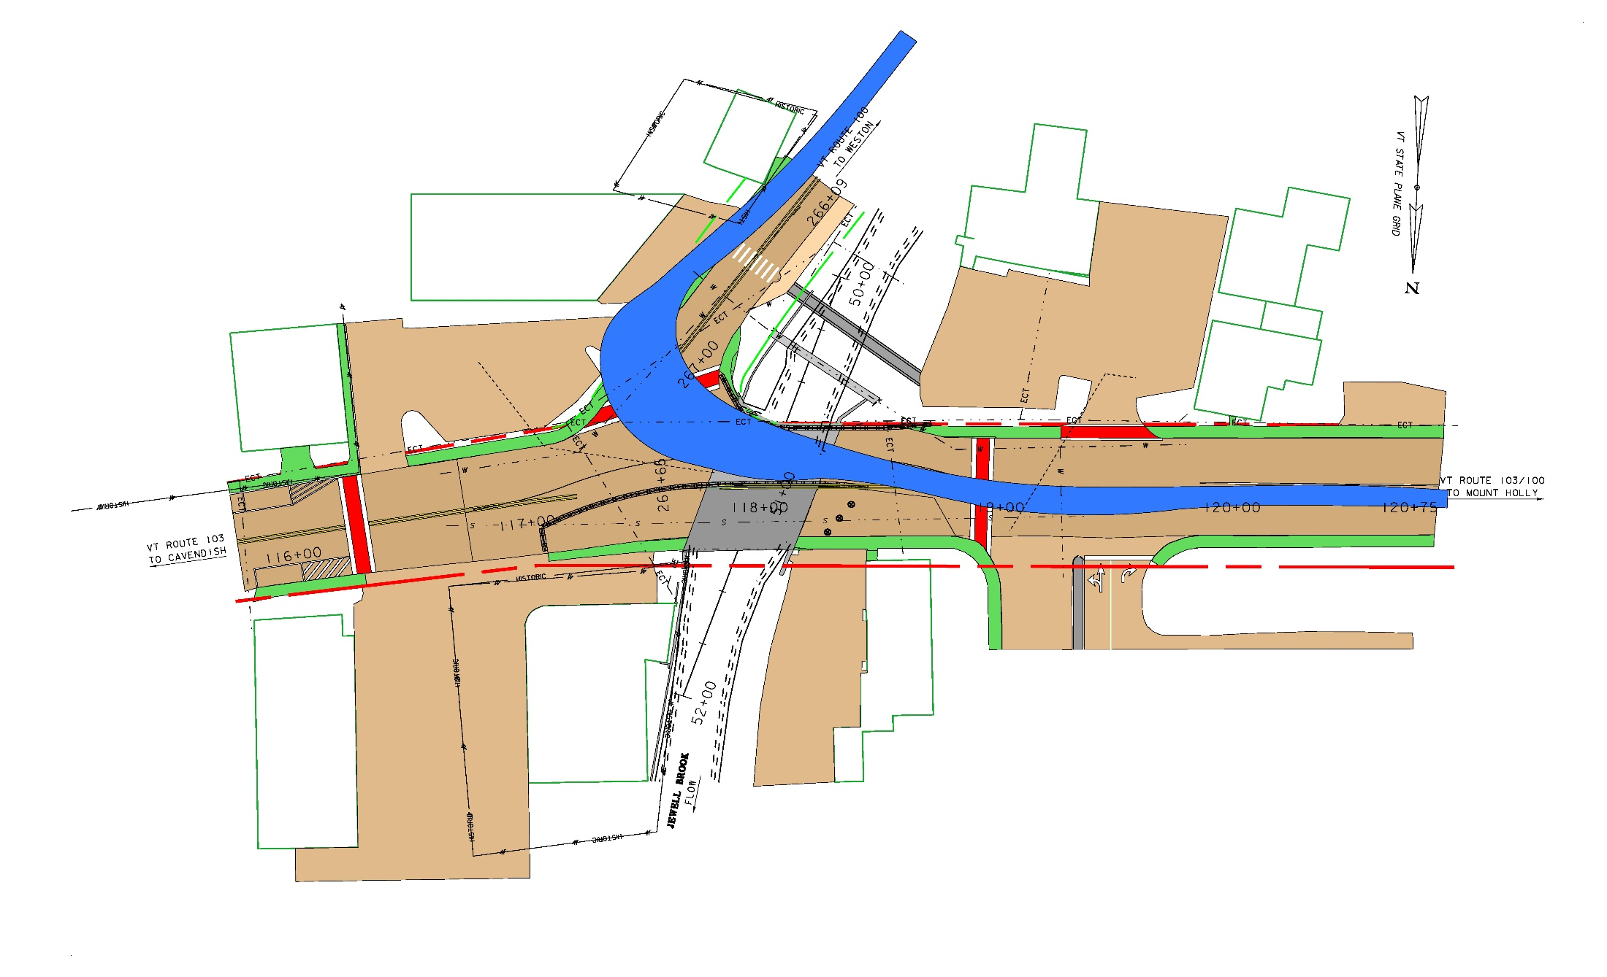
Truck Movements - Northbound

Slide 33
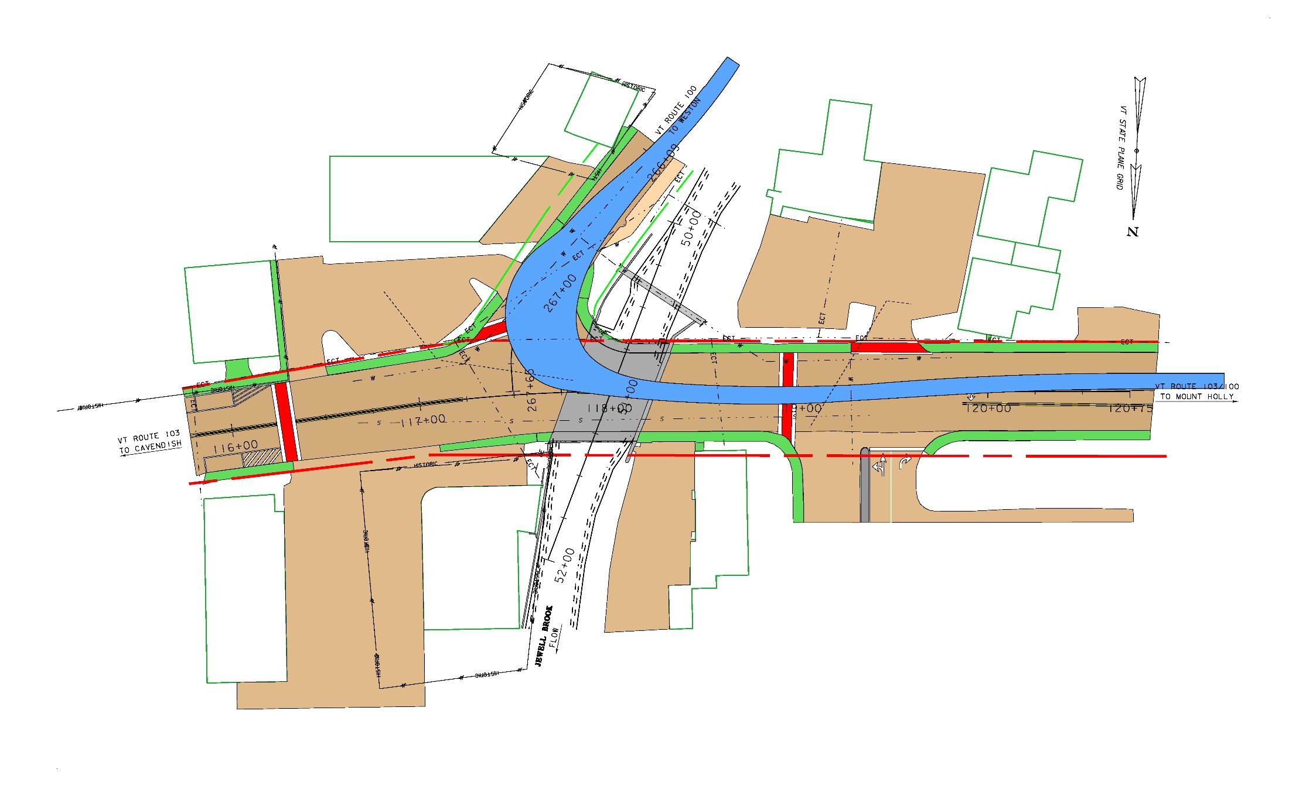
Truck Movements - Southbound

Slide 34
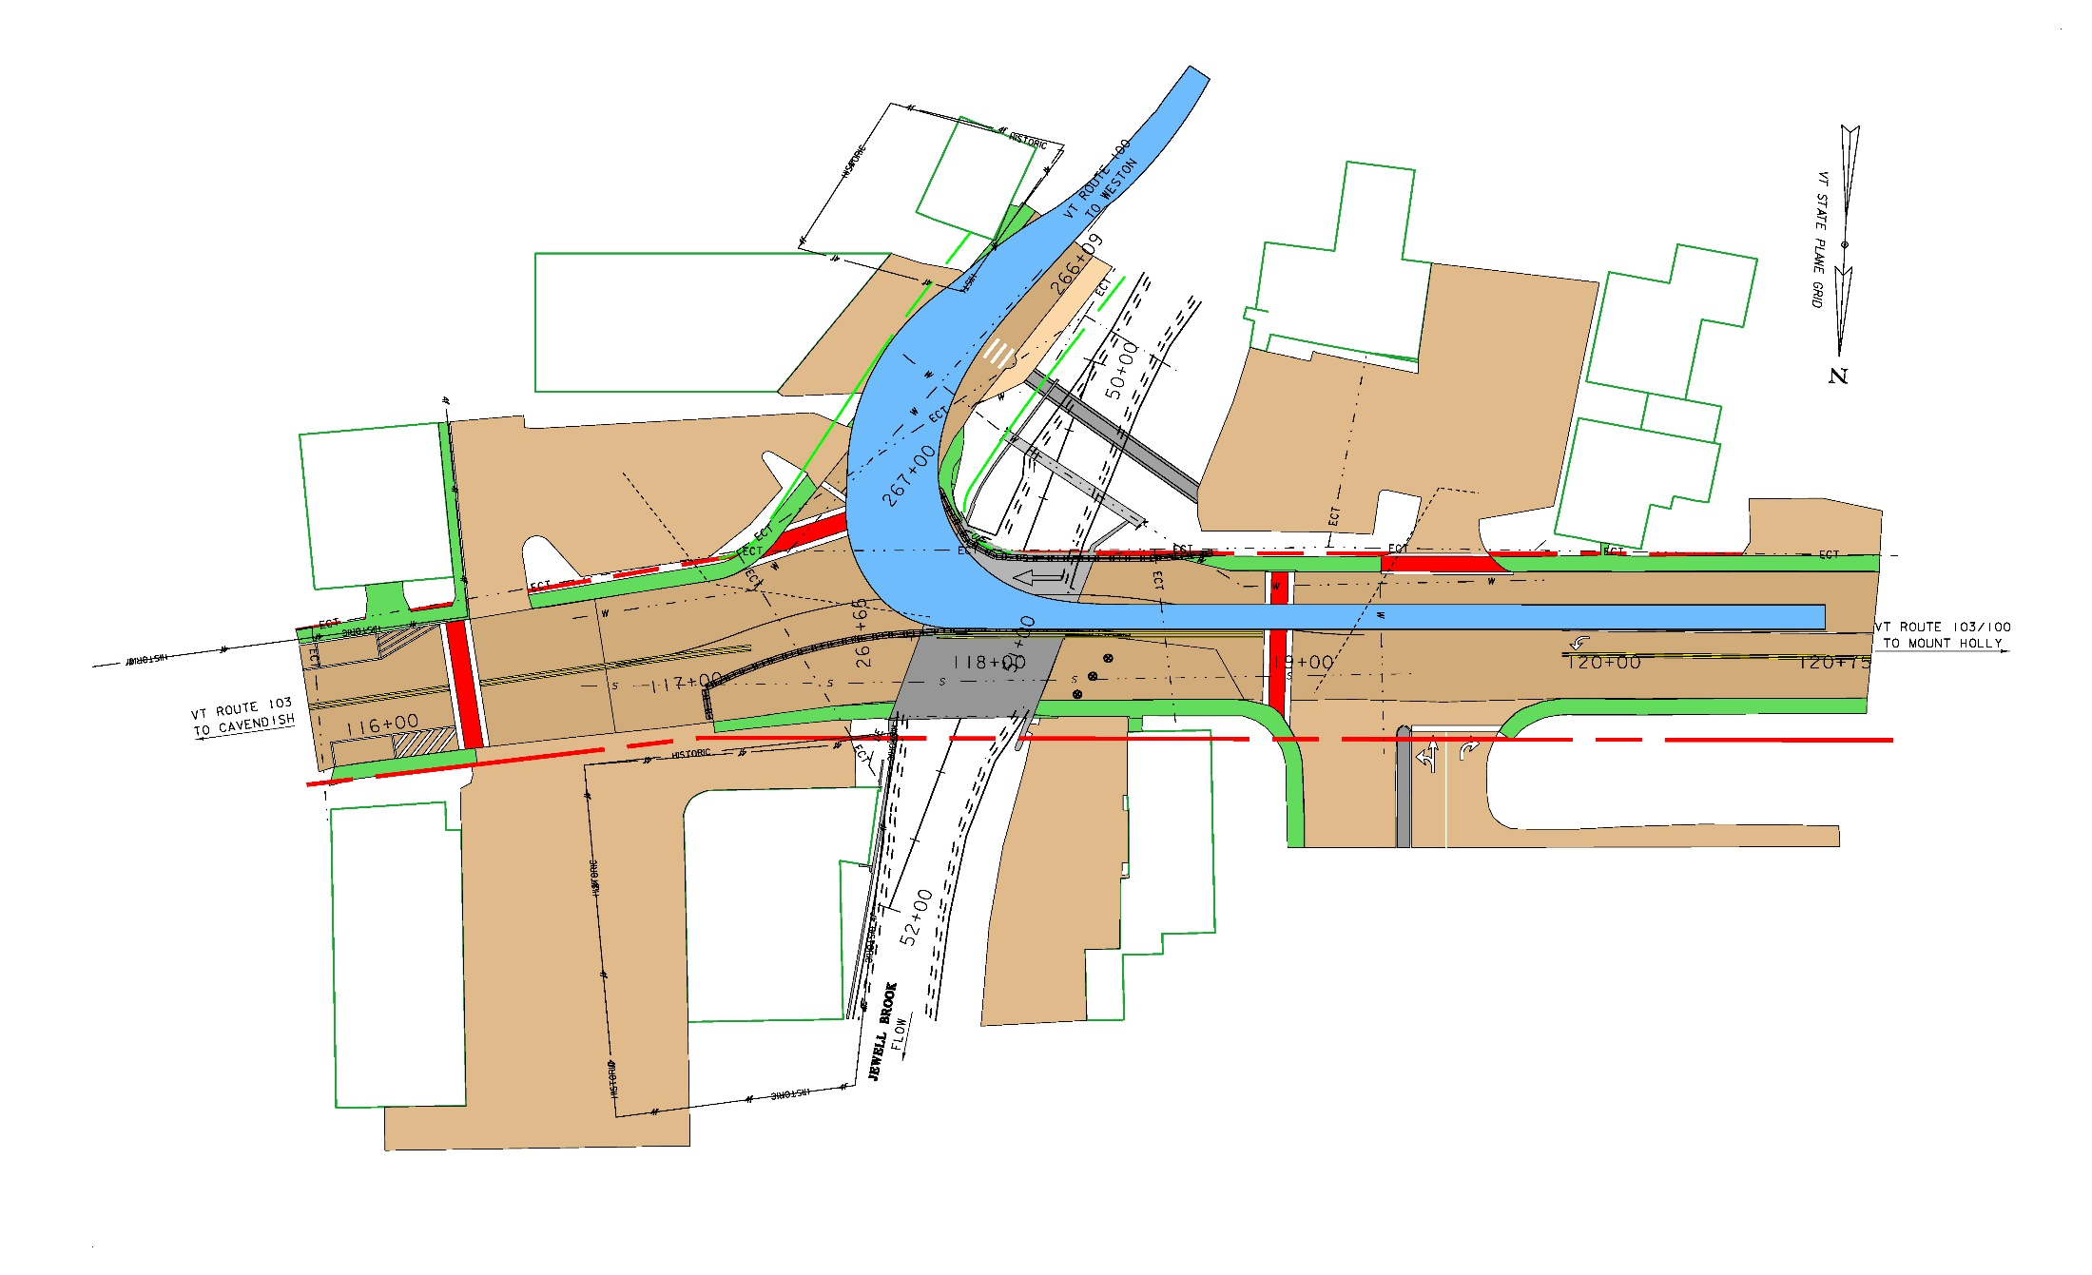
Truck Movements - Southbound

Slide 35
Town Considerations
Describe floods experienced at the site.

Slide 36
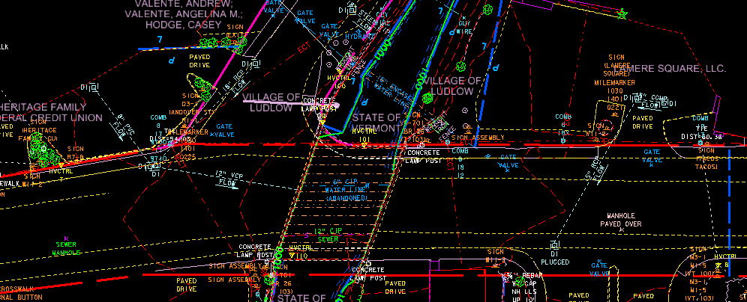
Town Considerations
Does the ROW look correct?

Slide 37
Town Considerations
Confirm bicycles to transit work zone in travel lanes.

Slide 38
Town Considerations
Pedestrian passage during construction

Slide 39
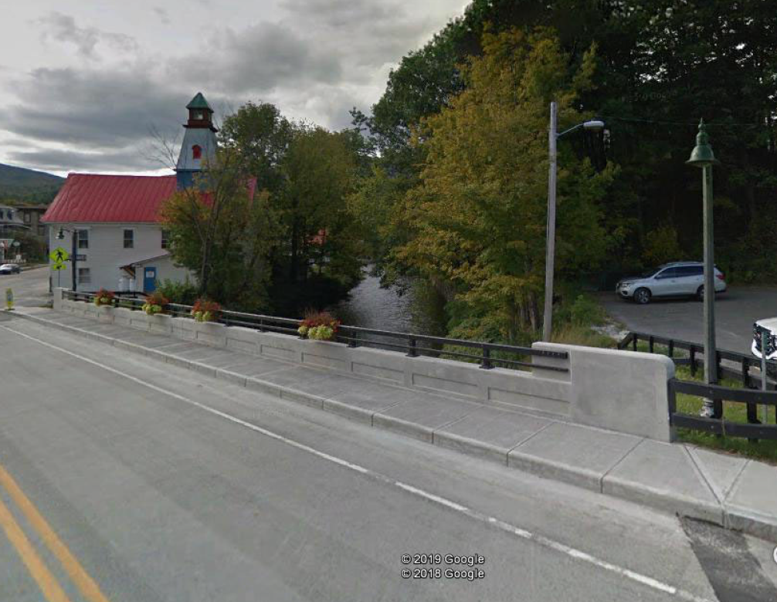
Town Considerations (contin)
Confirm proposed Bridge Rail.

Slide 40
Town Considerations (contin)
Confirm general project schedule – May through October.

Slide 41
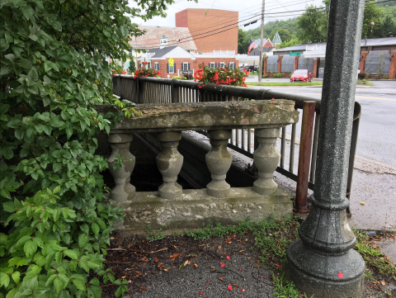
Town Considerations (contin)
Confirm treatment of original rail pieces and light poles (ie remove, preserve, and re-install).

Slide 42
Next Steps
Town confirms Items of Discussion at this meeting
Town signs Finance and Maintenance Agreement
Vtrans moves into Conceptual Design Phase

Slide 43
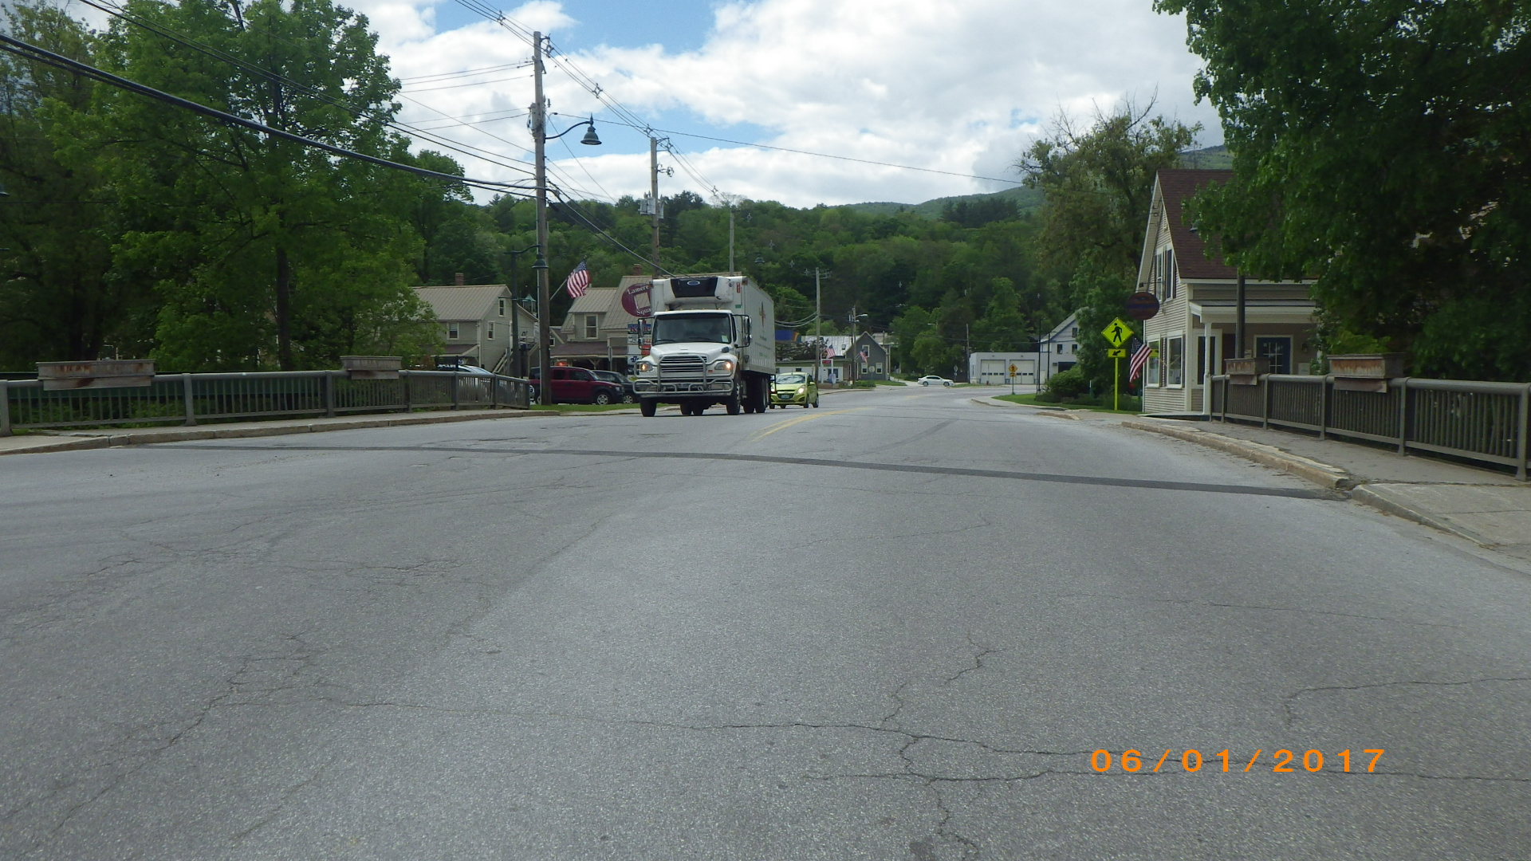
Ludlow Village: NH Deck (49)
Questions and Comments
TH-1 (Main St.) – Bridge #26 over Jewell Brook
For more information:
https://outside.vermont.gov/agency/vtrans/external/Projects/Structures/18j009
September 2019

Slide 44
Proposed Project - Bridge #26
Bridge Deck and Superstructure Replacement with Traffic Maintained on two lanes in each direction
VT100 Typical
  11’ Southbound Lane/1’ Shoulder
  10’Northbound Lane/2’ Shoulder
TH-1 (Main St.) Bridge Typical
  12’ Travel Lanes/10’ Shoulders/5’-0” Sidewalk/Combination Concrete/Steel Tubing Guardrails
VT 103 Typical
  12’ Travel Lanes/10’ Shoulders/5’-6” Sidewalks

Slide 45
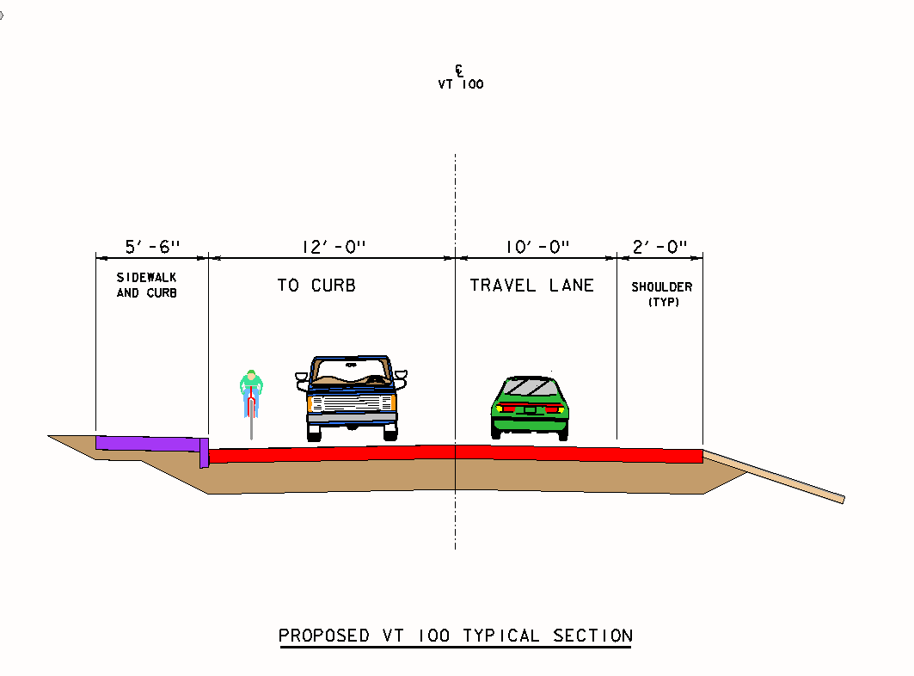
VT 100 Proposed Typical Section

Slide 46
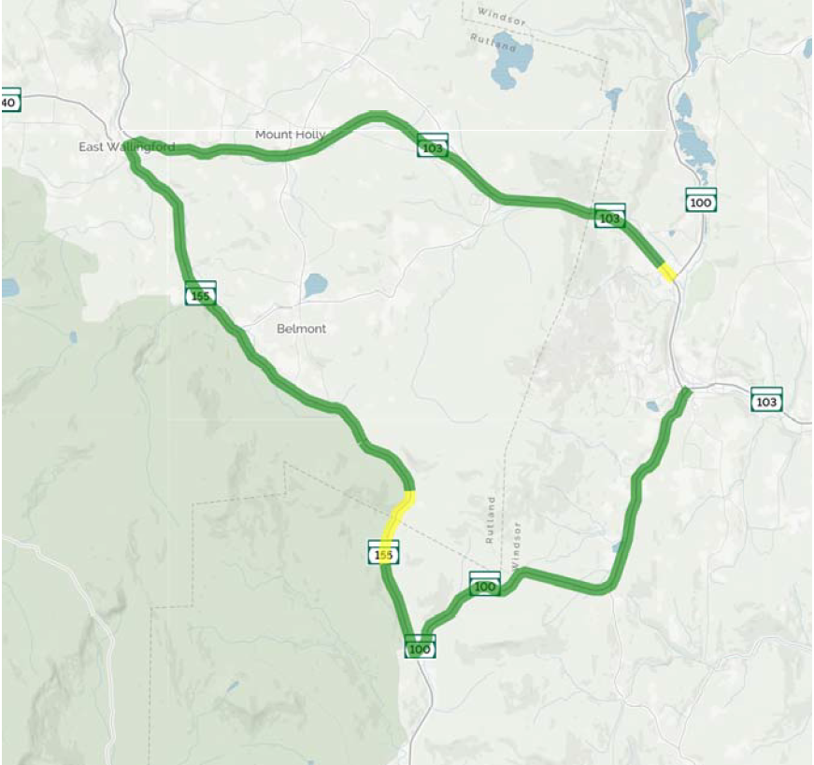
Regional Detour Route on State Owned Roads
26.5 Mile Trip

Slide 47
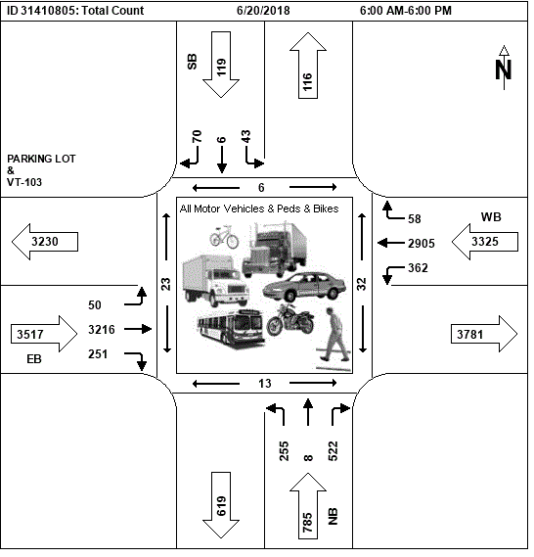
Design Criteria and Considerations
Traffic Data for VT 103 and VT 100 as of 2018
Speed Limit 30 mph
Source of data:
https://vtrans.ms2soft.com/tcds/tsearch.asp?loc=Vtrans&mod=

Slide 48
Maintenance of Traffic Options Considered
Offsite Detour
Temporary Bridge
Phased Construction

Slide 49
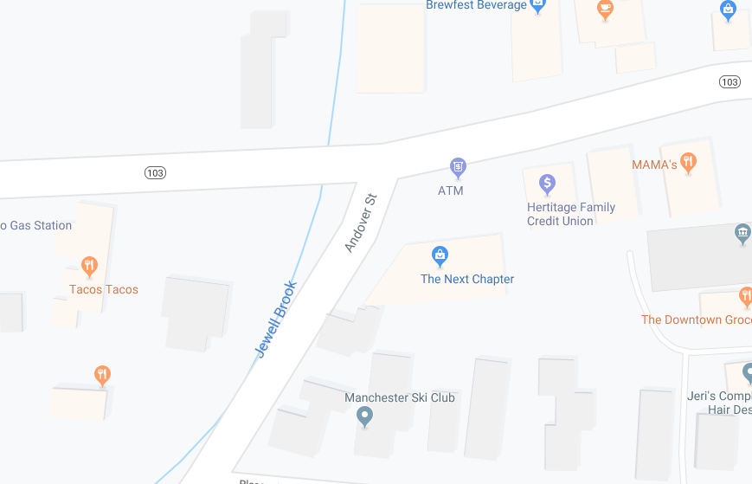
Ludlow Village Bridge 26
Location Map

Slide 50
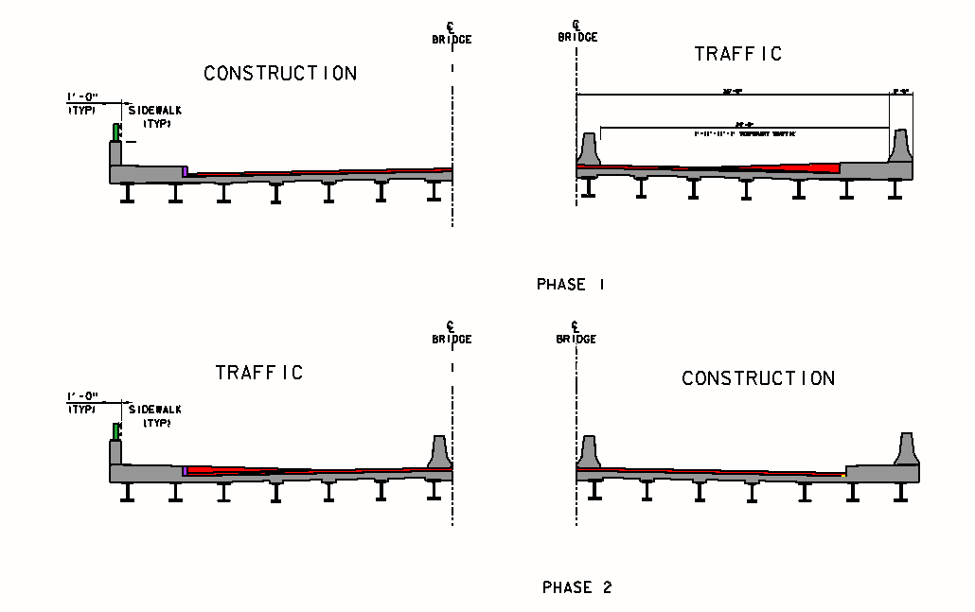
Proposed Maintenance of Traffic
Phased Construction

